Slide 1








SILVER SPOSOR
BRONZE SPOSORS
PARTNERS

Slide 2
KEY PERFORMANCE METRICS OF SQL SERVER
GRZEGORZ ŁYP

Slide 3

Grzegorz Łyp
MS SQL Architect & Optimizer
MS SQL, .NET & Java Developer
ElasticSearch & Grafana Architect
Product & Project Manager, Team Leader
22 years in professional IT
17 years in MS SQL
Member of Data Community Poland
Presenter at SQLDay, SQLBits, PassSummit, SQL Saturday
Mail: grzegorz.lyp@assecobs.pl
Twitter: @GrzegorzLyp
Github: https://github.com/GrzegorzLyp
LinkedIn: https://www.linkedin.com/in/grzegorzlyp/

Slide 4

Agenda
CPU Metrics
Memory Metrics
Disk Metrics
Other Metrics

Slide 5
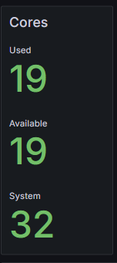
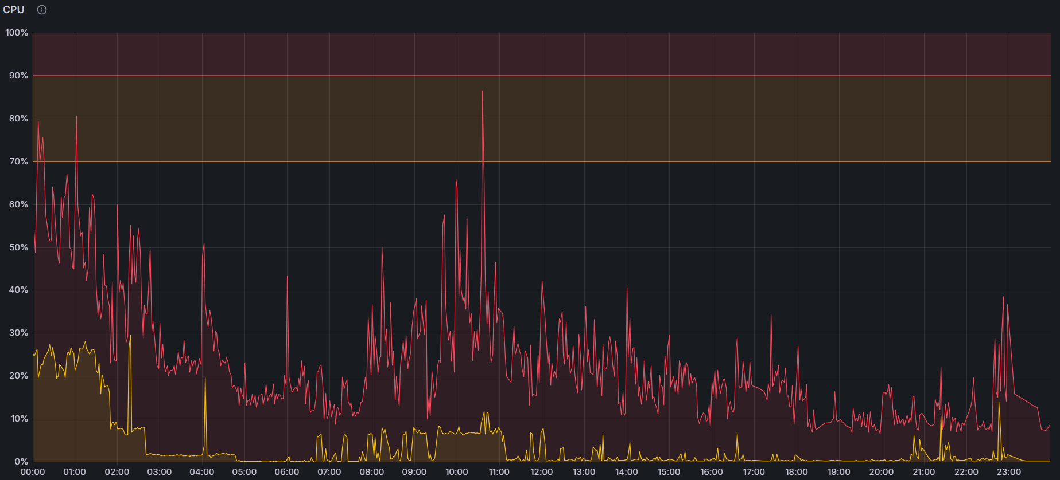
CPU Metrics
Cores (Threads), System CPU and SQL Server Instance CPU

Slide 6
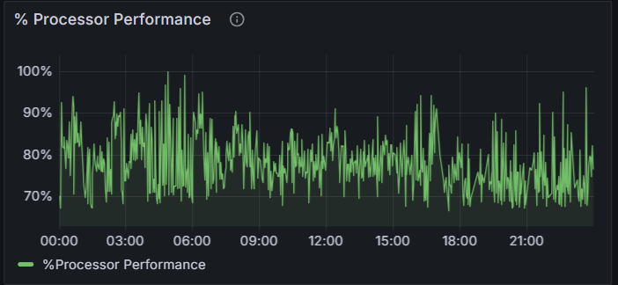
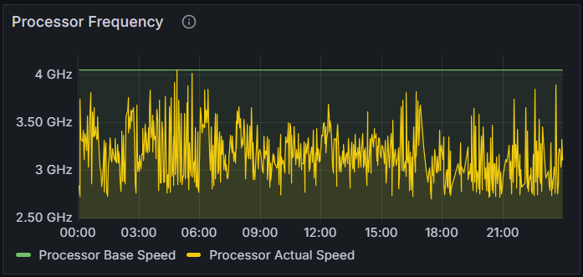
CPU Metrics
CPU Performance

Slide 7
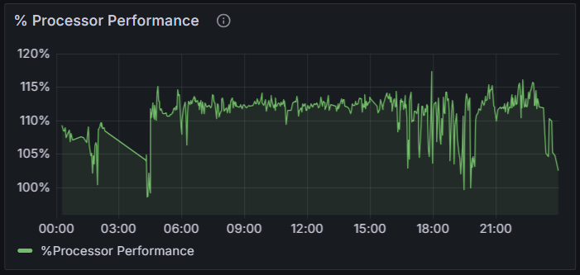
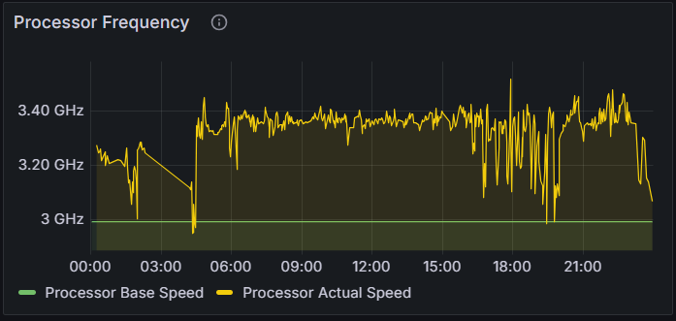
CPU Metrics
CPU Performance

Slide 8
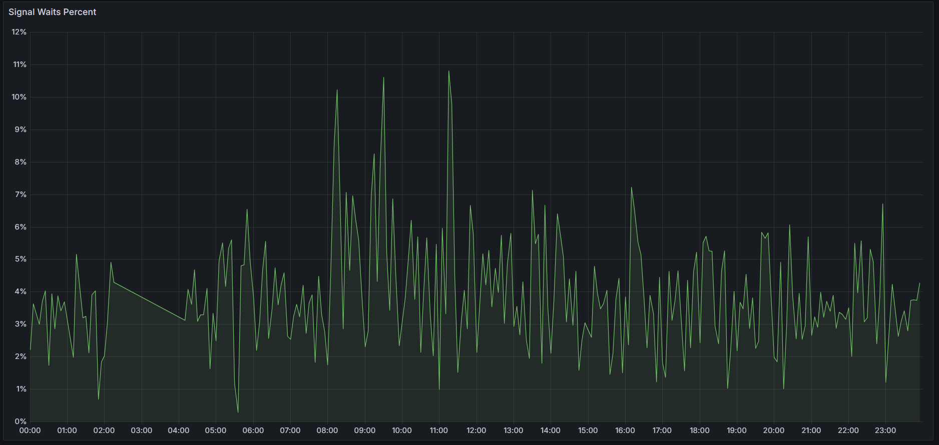
CPU Metrics
Signal Waits Percent
High CPU preasure inidicator
Typically high on VM based systems
SELECT SUM(signal_wait_time_ms*1.)/SUM(wait_time_ms)*100 FROM sys.dm_os_wait_stats

Slide 9
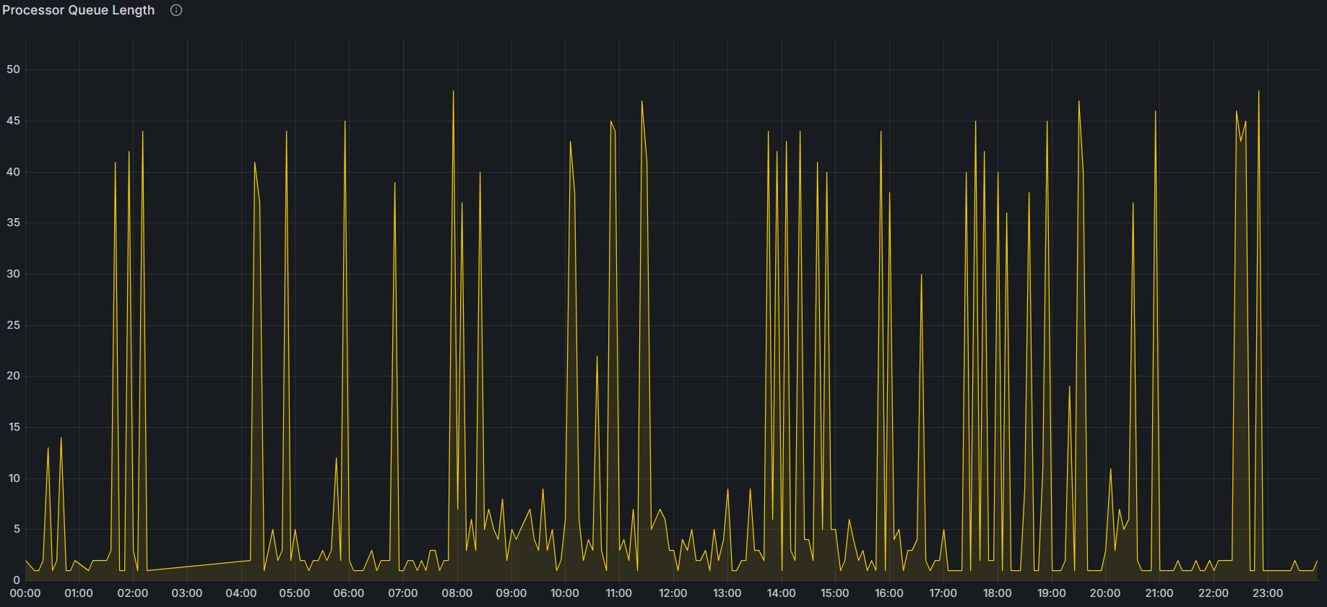
CPU metrics
Processor queue length

Slide 10
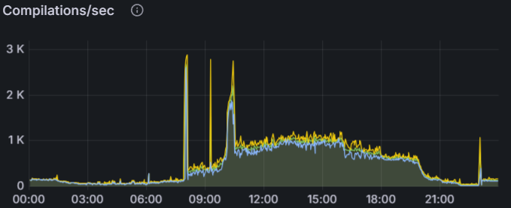
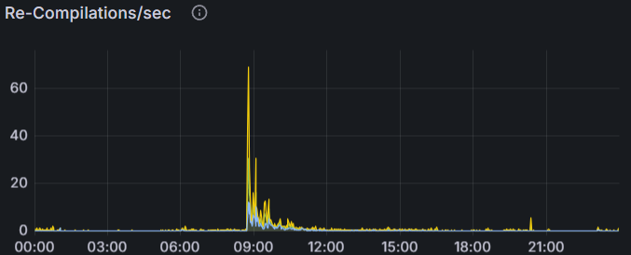
CPU metrics
Compilations
Re-Compilations

Slide 11
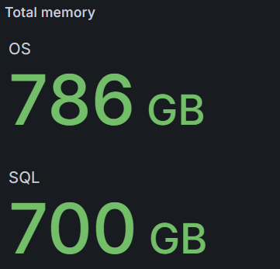
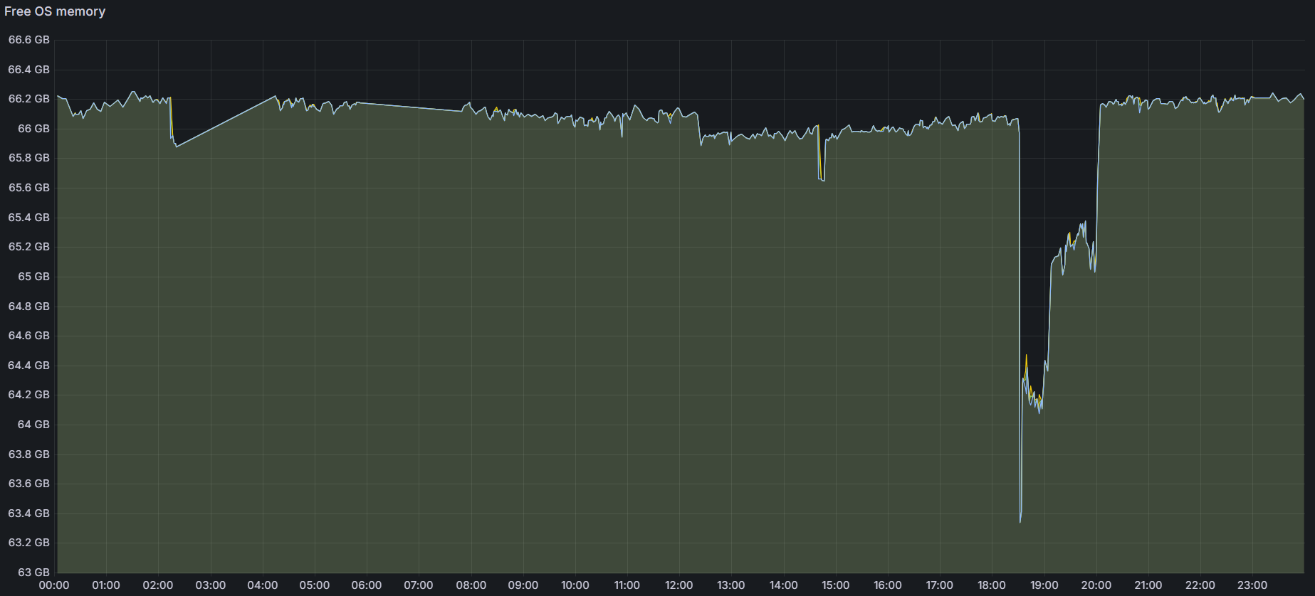
Memory Metrics
Total OS and SQL Instance memory

Slide 12
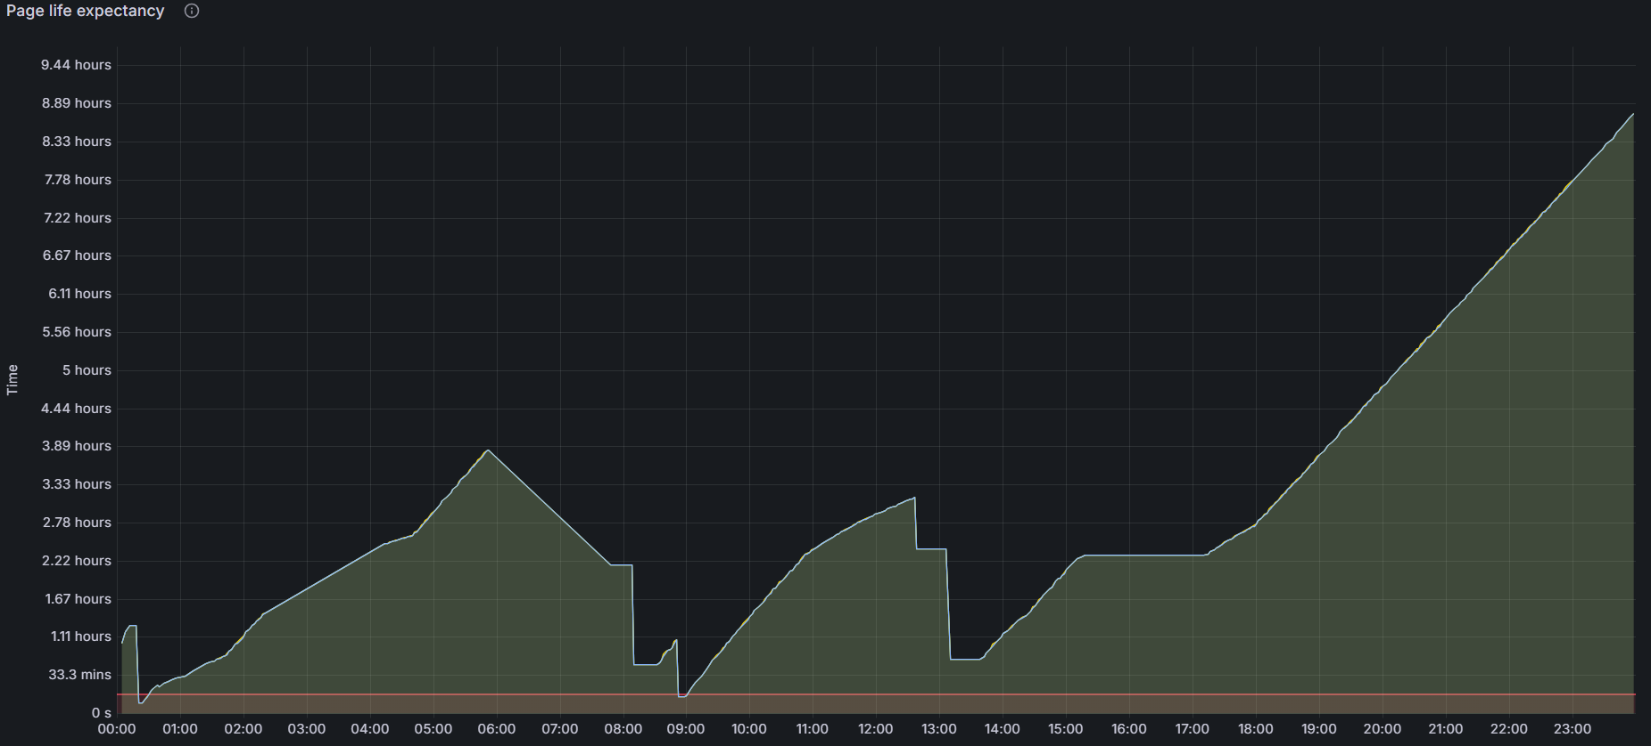
Memory Metrics
Page Life Expectancy

Slide 13
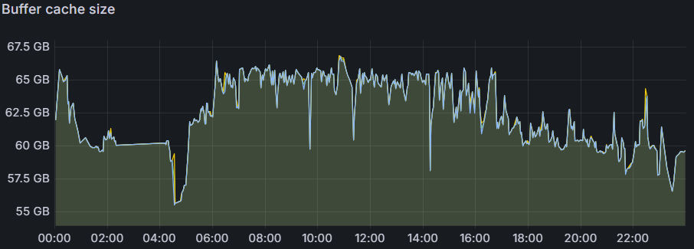
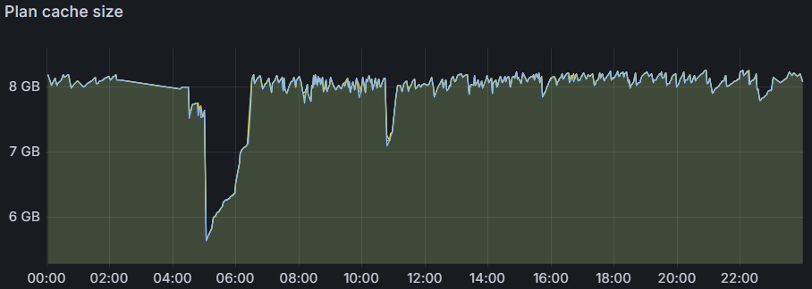
Memory Metrics
Plan Cache Size
Buffer Cache Size

Slide 14
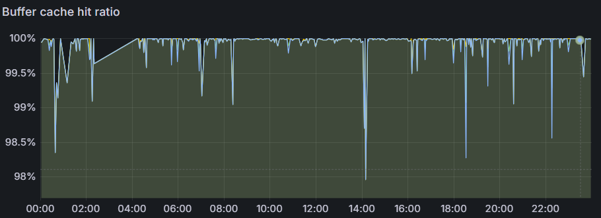
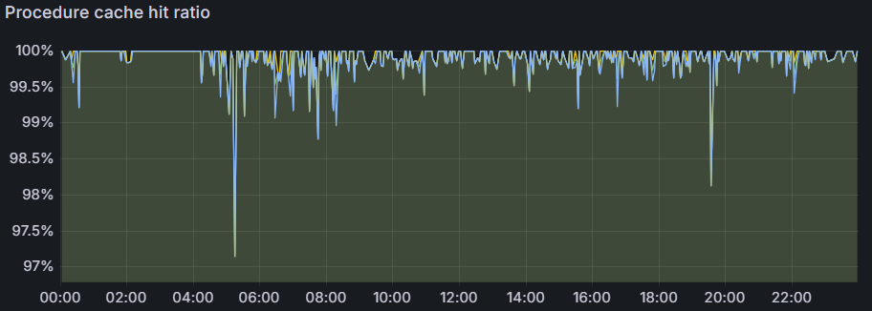
Memory Metrics
Plan Cache Hit Ratio
Buffer Cache Hit Ratio

Slide 15
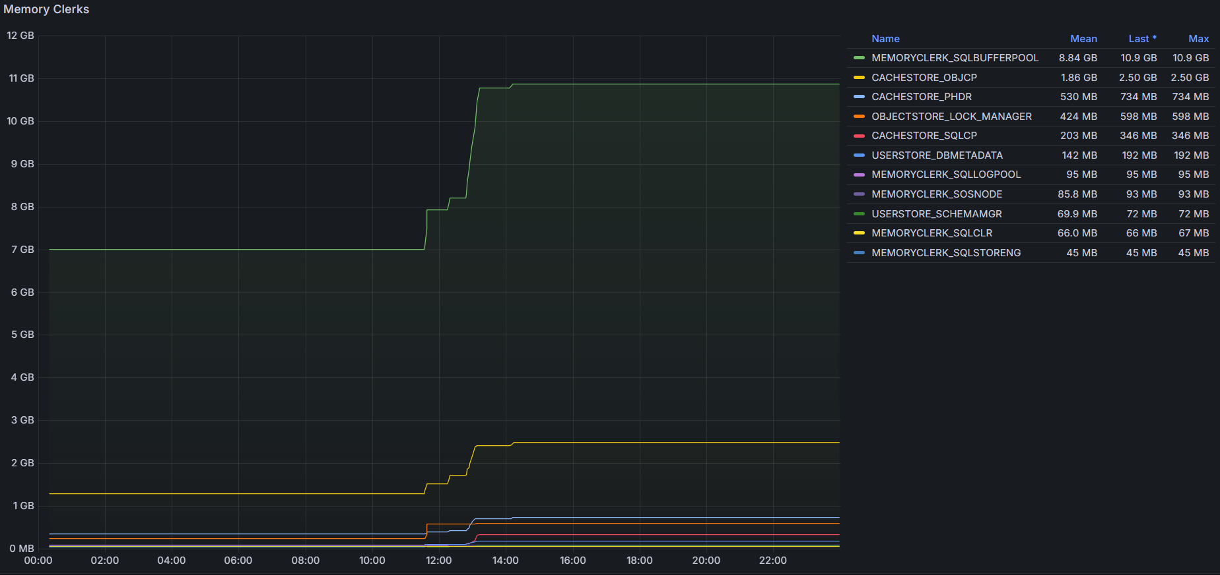
Memory Metrics
Memory Clerks

Slide 16
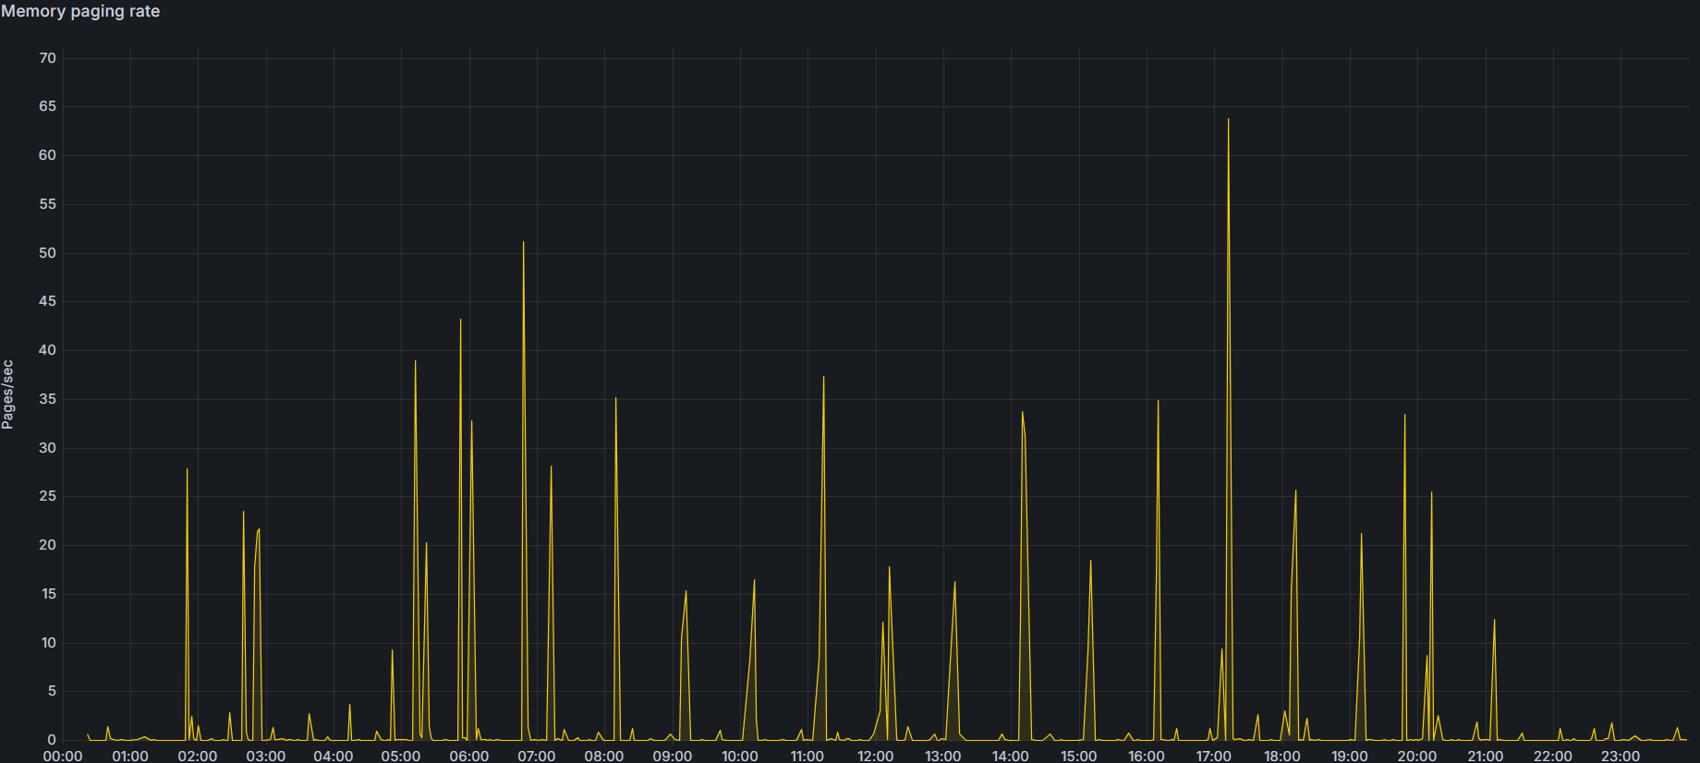
Memory Metrics
Memory Paging Rate

Slide 17
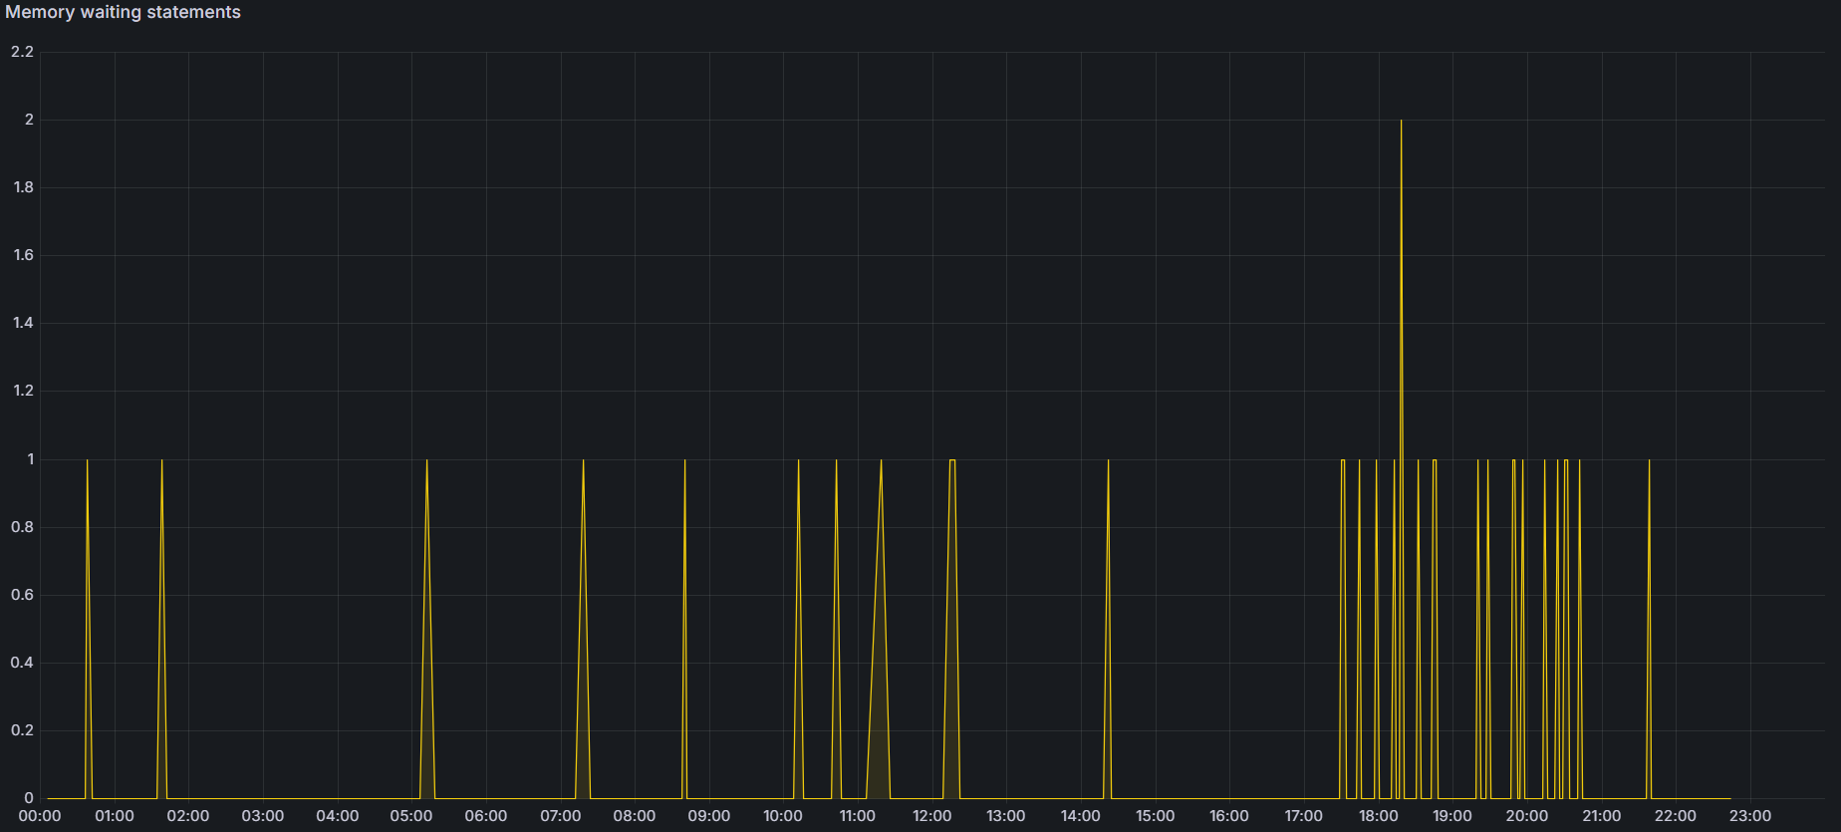
Memory Metrics
Memory Waiting Statements
SELECT COUNT(1) FROM sys.dm_exec_query_memory_grants WITH (NOLOCK) WHERE grant_time IS NULL

Slide 18
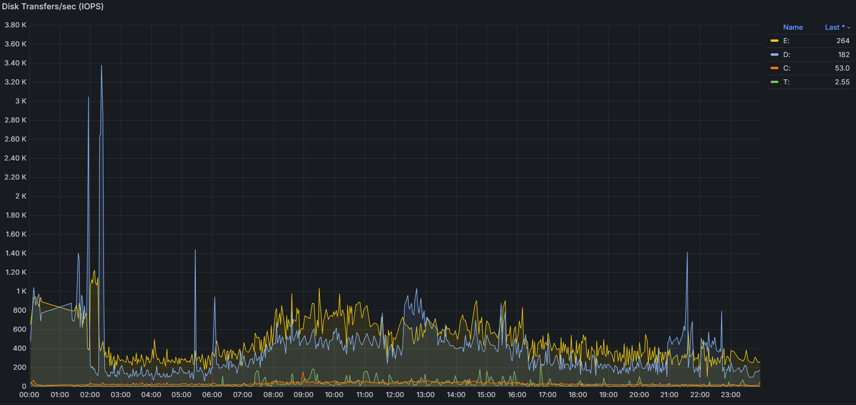
Disk Metrics
IOPS (Data Transfers/sec)

Slide 19
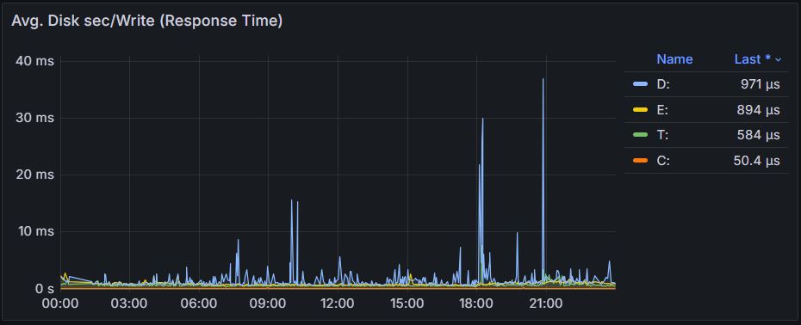
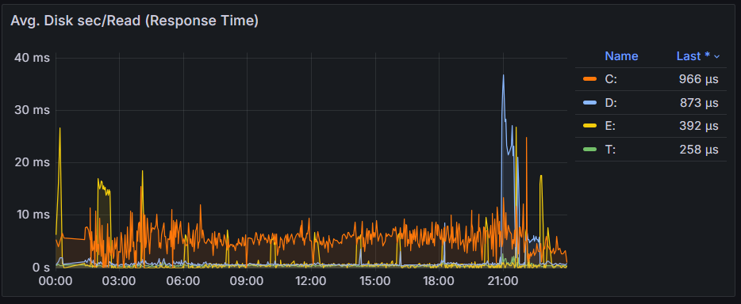
Disk Metrics
Response Time

Slide 20
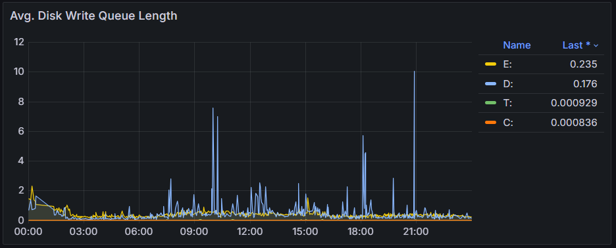
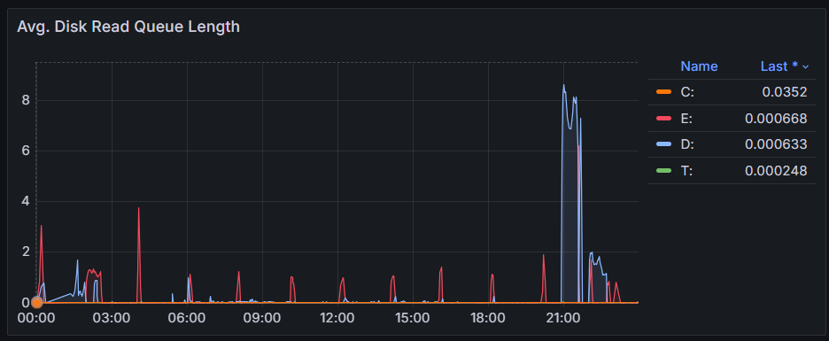
Disk Metrics
Avg Queue Length

Slide 21
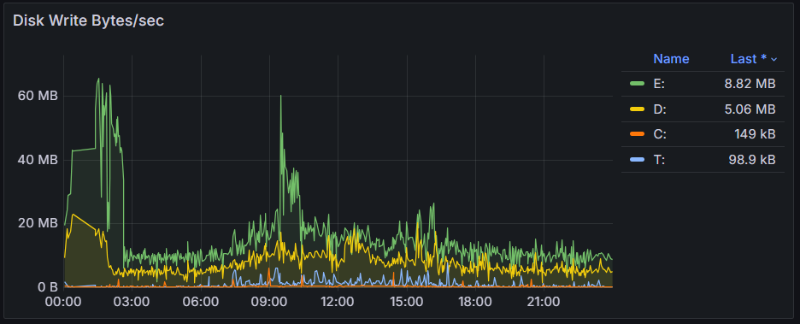
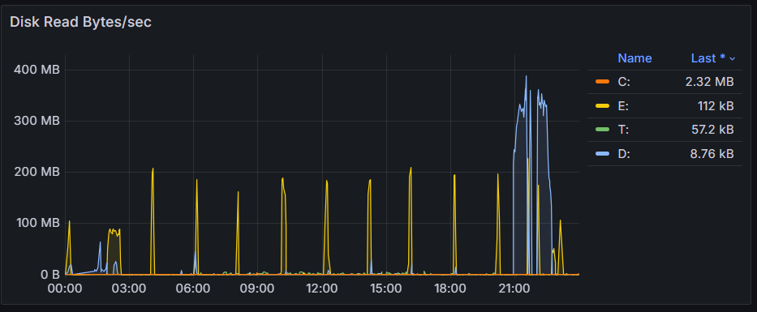
Disk Metrics
Disk Read/Write Bytes

Slide 22
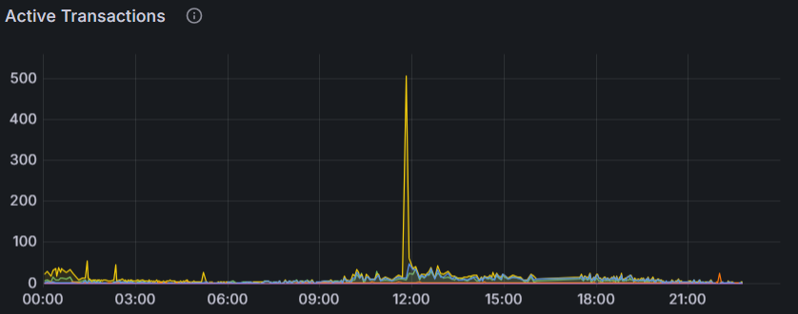
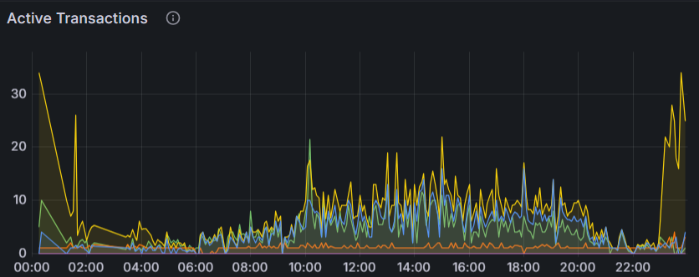
Other Metrics
Active
Transactions

Slide 23
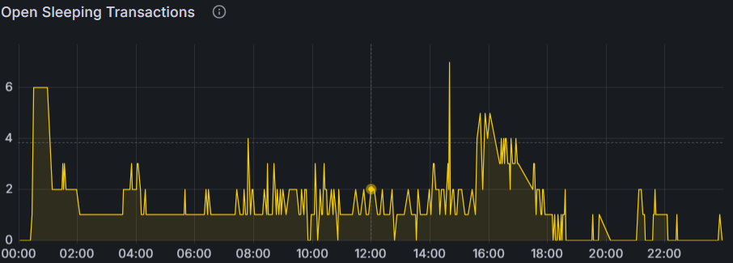
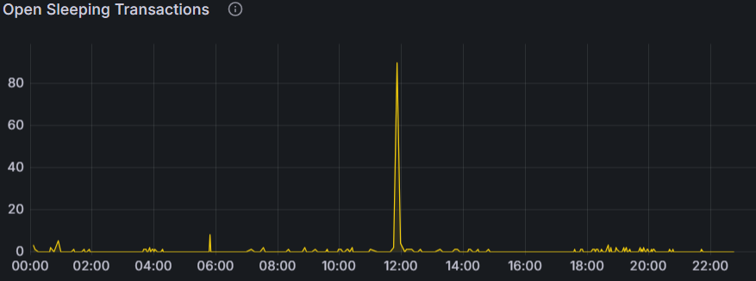
Other Metrics
Open Sleeping Transactions
SELECT COUNT(1) FROM sys.dm_exec_sessions WITH (NOLOCK)
WHERE open_transaction_count>0 AND STATUS = 'sleeping'

Slide 24
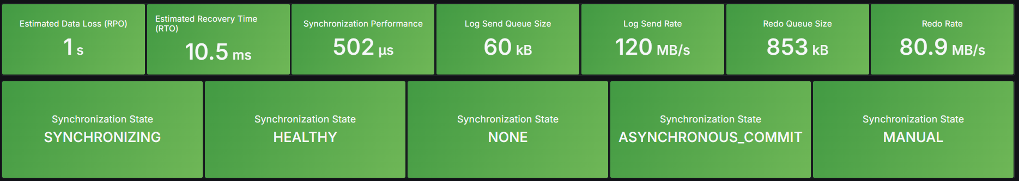
Other Metrics
AlwaysOn Performance

Slide 25
THANK YOU

